Slide 1
Ocean Acidification Module - Lesson Pictures
(refer to “Lesson Flow” for timing)
(can be adapted…)

Slide 2
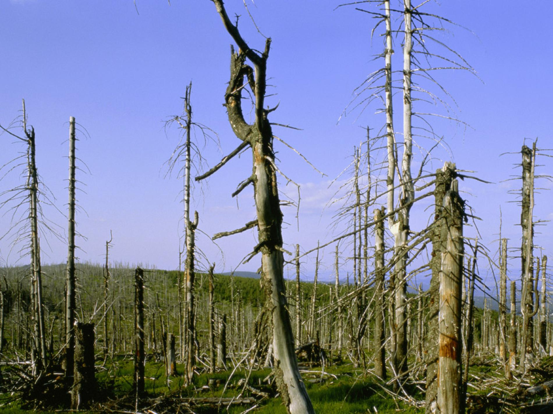
Why does acidity matter?

Slide 3
Good laboratory practices
Wear gloves at all times when handling chemicals/solutions
Safety goggles
Use different containers for different solutions
Never use a container twice without properly washing it
Identify containers
Write down everything!

Slide 4
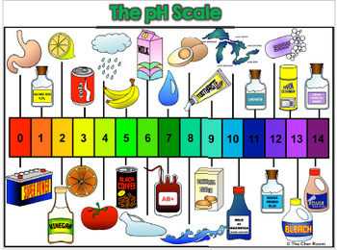
How do we measure acidity?
pH: quantitative measure of acidity/basicity
If between 0 and 7, then solution is acid
If between 7 and 14, solution is basic
If 7, solution is neutral

Slide 5
(Older students) What exactly is pH?
Acid = molecule that can give an H+ ion
HF = H+ + F-
H2O = H+ + OH-
H2CO3 = H+ + HCO3-
HCO3- = H+ + CO3(2-)
Concentration = quantity / volume
pH = - log( [H+] )

Slide 6
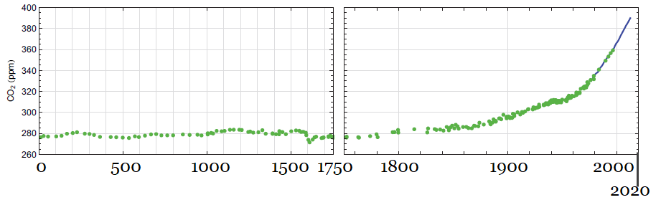
CO2 in the atmosphere

Slide 7
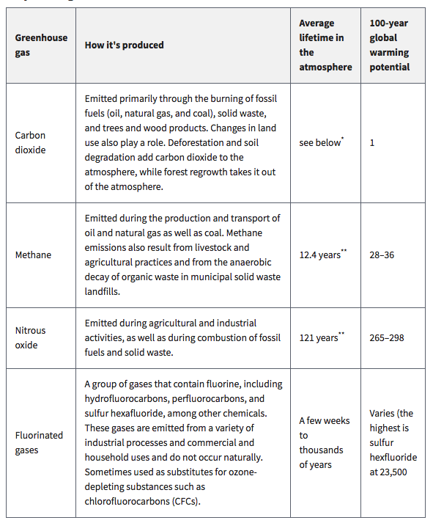
Greenhouse gases

Slide 8
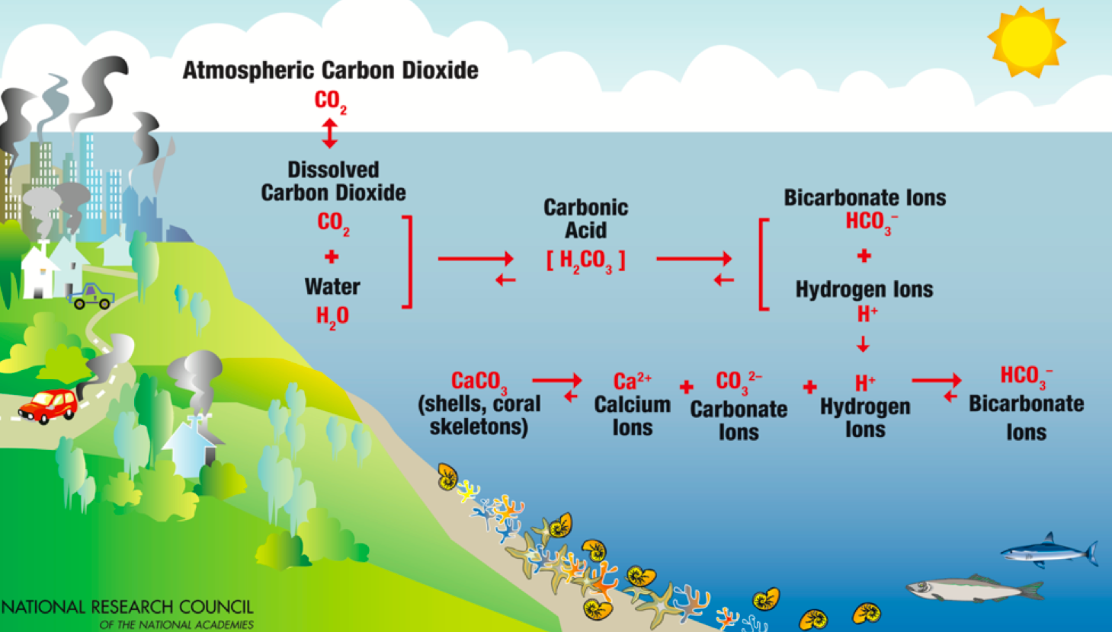
Carbon cycle

Slide 9
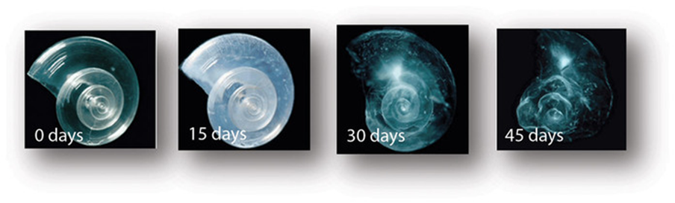
Effects of ocean acidification

